Slide 1


Training feedforward and convolutional neural networks on a ciphar100 image dataset: summary of what has been achieved so far
Ana Marija Eres; Dominik Kos; Ema Ilic; Martin Srsen
Erasmus Students, Deep Learning 103000856
22/03/2021

Slide 2
Three Pillars of Our Work
Appropriate Methodology
Understanding the fundamentals
Maximizing Accuracy
Notes:
Our goal was not just to maximize the accuracy, moreover it was applying the correct methodology and understanding what we we’re doing. We tried balancing that with achieving good accuracy, keeping in mind that ultimately it is the process and the methodology applied that counts.

Slide 3
Methodology and Accuracy (FFNN)
Randomized Search Cross Validation (Keras)
“Trial and Error” Method
So far, the results observed for FFNN were interesting:
For a randomized search considering only the optimizer, we obtain accuracy 0.151075 with Adam
For a randomized search considering only the activation function, we obtain accuracy 0.147500 with ReLu
For a randomized search considering activation, dropout rate, number of layers, number of neurons per layer and learning rate, the accuracy is 0.1154
With “trial and error” method, we obtain the validation accuracy of 0.31020, test loss of 3.69523 in 1.16442 seconds

Slide 4
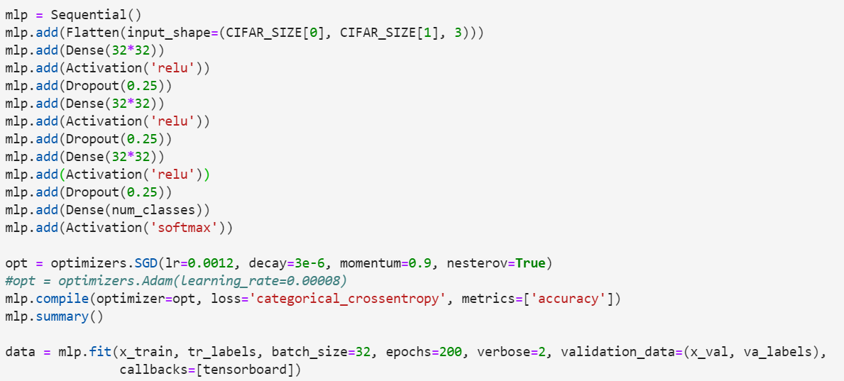
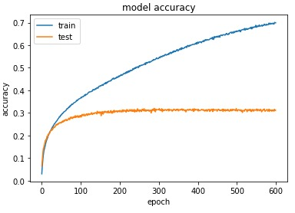
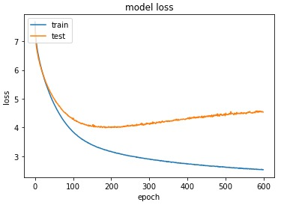
Most Successful “Trial and Error” FFN Model
fNN took 1.1644279956817627 seconds
Test loss: 3.6952316761016846
Accuracy: 0.3102000057697296

Slide 5
Methodology and Accuracy
Due to a lack of computational resources and the lengthy process of the cross validation algorithm, the CNN was trained using the careful study of the theory and the ‘trial and error’ method
The most successful Model on the following slide

Slide 6
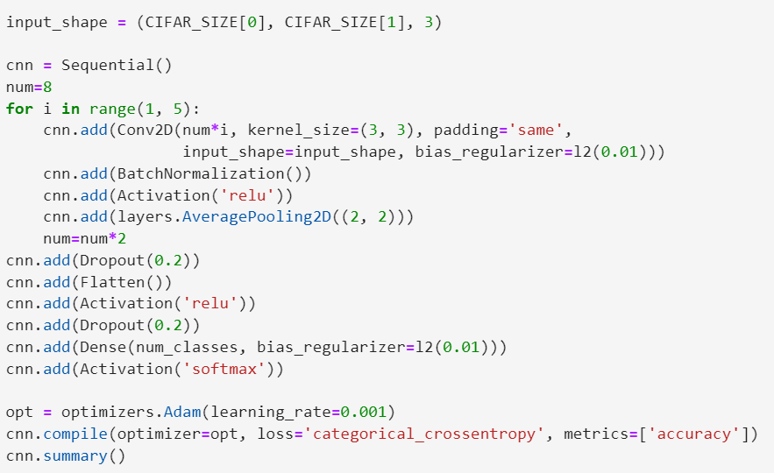
Four Convolutional layers were added using a for loop, with the number of output filters taking on increasing values, with the kernel of height and width 3 of the convolutional window, a default stride (1,1), and a ridge regression penalization. Along with each of the layers in the loop we added:
a batch normalization step was added which further increased the accuracy. This step applies a transformation that maintains the mean output close to 0 and the output standard deviation close to 1
ReLu activation function was chosen
dropout rate o 0.2
an average pooling layer with a pool size of (2,2), halving the input in both spatial dimensions

Slide 7
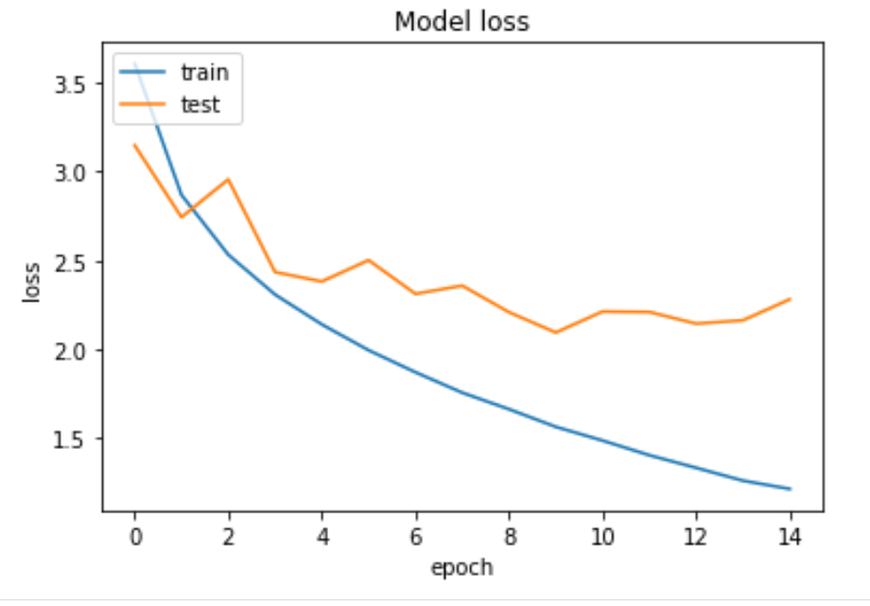
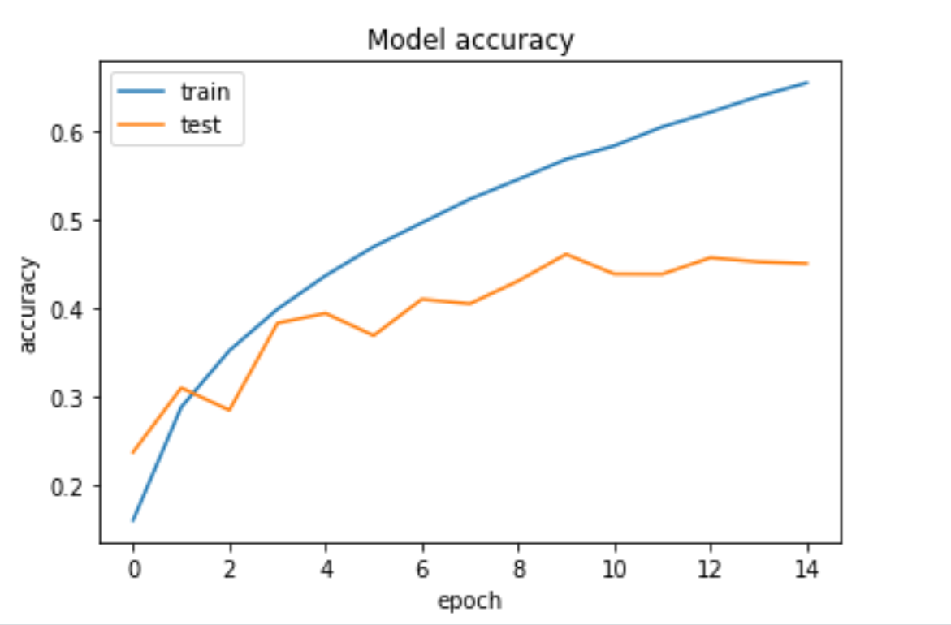
Success of a Convolutional Neural Network Using the “Trial and Error” Method
Time: 1.57887s
Test Loss: 2.22764
Accuracy: 0.453000

Slide 8
Problems encountered
Kernel crashing and interrupting the process while doing grid search and training the models.
Solution implemented: Grid search only one hyperparameter every time.
Solution Implemented: Use Randomized Search rather than Grid Search to reduce computational cost
Layer Limitation in building a CNN is 8 before ResourceExhaustedError
Solution Implemented: Build a model with less than 8 layers and leverage on the other properties of the CNN
Slowness of computation due to a lack of parallelization: n_jobs had to be set at 1 in order to successfully run the code which significantly slowed down the process as it couldn’t be parallelized
Randomized Search Cross Validation reached lower results than the “trial and error” method
This is due to the Randomized Search algorithm only taking n random combinations of hyperparameter values and selecting the best model out of those, compared to the Grid Search which trains a model on all of the possible combinations of hyperparameter values

Slide 9

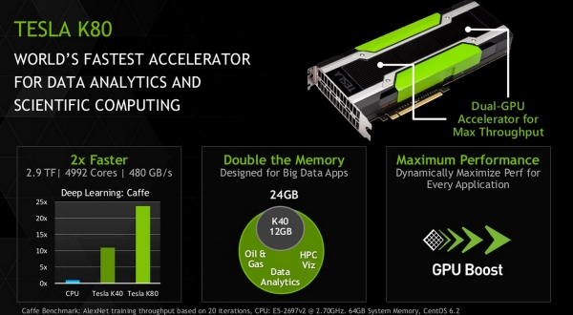

Software and Tools Used
Google Cloud Console
1xNvidia Tesla K80 GPU
Compute Engine’s Deep Learning Virtual Machine Instance (Tensorflow)
Python 3.8 (Tensorflow2.4 and Keras.CUDA11.0.GPU

